Slide 1
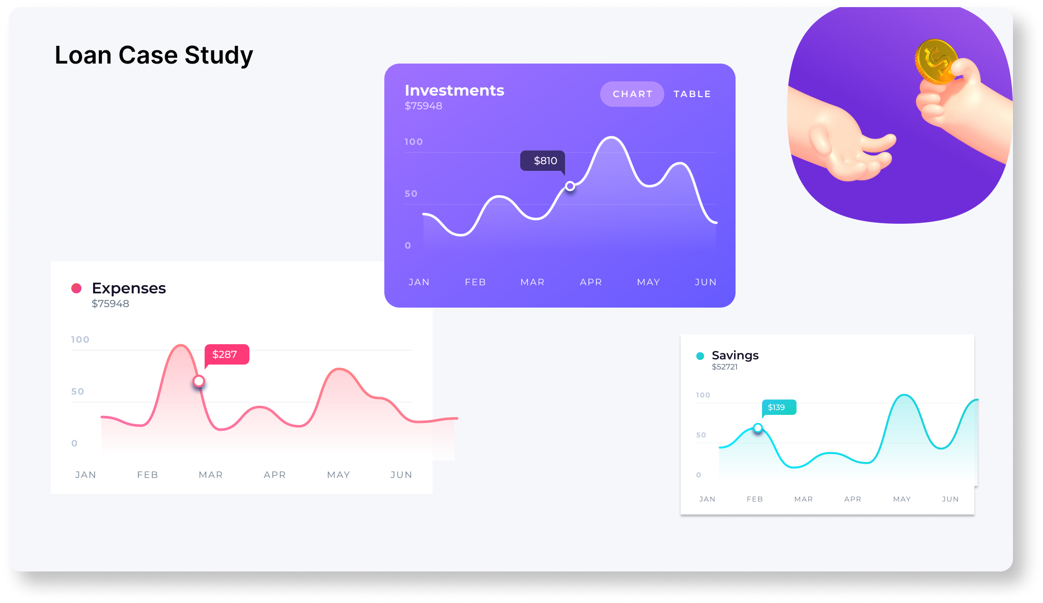
BANK LOAN CASE STUDY
By Sudhansu

Slide 2
AGENDA
Project Description
Approach
Tech-Stack Used
Data Cleaning
Insights
Result
Python Jupyter Notebook hyperlink : click on this
Jupyter Notebook as .ipynb
Link for: Juypyter notebook as pdf

Slide 3

Project Description
The bank is facing challenges, they are facing financial losses and losing business due to approval loans to the clients who can’t repay and rejecting those who can repay.
Using EDA to understand how customer attributes & loan attributes influence the likelihood of default. Identifying key factors that indicate a customer credit worthiness. This information can be used to make decisions such as denying the loan, reducing the amount of loan, or lending at a higher interest rate to risky applicants

Slide 4
Approach
Downloaded and imported the dataset in Jupyter Notebook, performed data cleaning i.e. removing missing & invalid rows and handling outliers. Used NumPy, pandas and matplotlib/seaborn chart to draw graphs and finding insights. And finally drawn conclusions from insights and made recommendations
Tech-Stack Used
Software: Python 3.10.12
Version: Jupyter Notebook 6.4.6
Purpose: Data cleaning and visualization
I used Python and Jupyter Notebook to clean and visualize data because these tools are powerful and versatile. Python is a general-purpose programming language that can be used for a variety of tasks, including data cleaning and visualization. Jupyter Notebook is an interactive environment that makes it easy to write and run Python code.

Slide 5
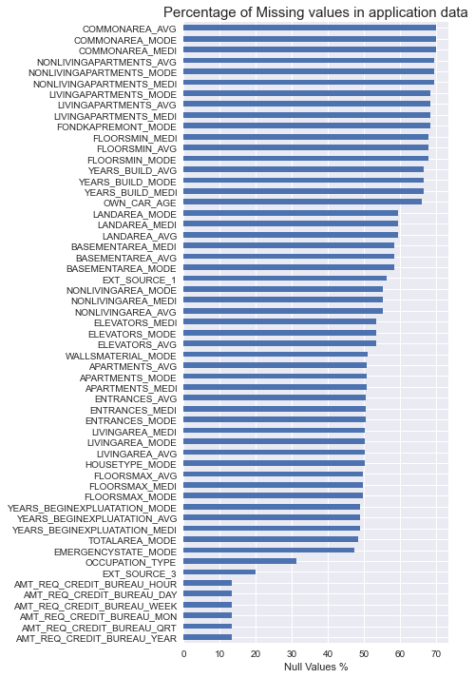
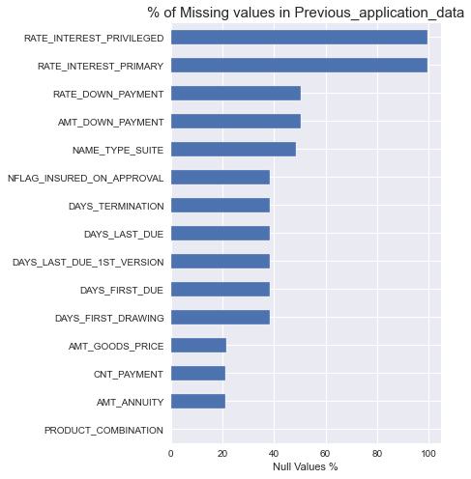
Data Cleaning
APPLICATION DATA
removed all the null values from the application_data dropping 52 columns and 194 rows
all variable with missing values greater than 40% are dropped.
variables with missing values below 13% are imputed with median values.
insignificant null rows of variables are removed.
PREVIOUS APPLICAION DATA
removed all the null values from the previous_application_data dropping 11 columns and 8 rows
all variable with missing values greater than 38% are dropped.
and rest missing values are imputed with median values and insignificant rows removed.
A. Handling Missing values of
Application data &
Previous Application data

Slide 6
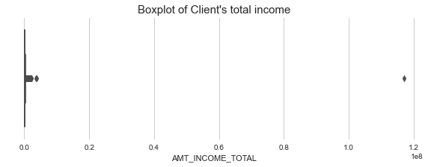
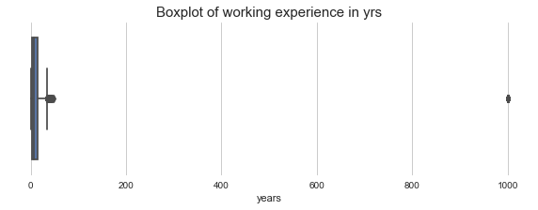
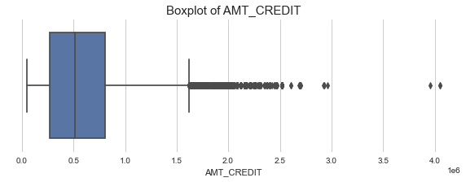
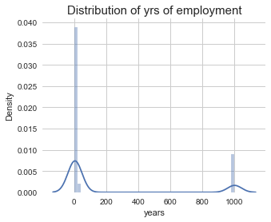
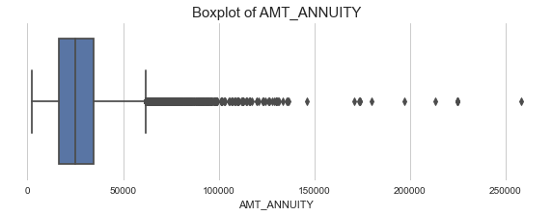
Data Cleaning
B. Handling Outliers of
Application data &
Previous Application data
removed client with exceptionally high income as it can distort our analysis for general trend.
replaced invalid values of years_employed ie. "1000yrs" by median value.
created bucket for client’s age, income and credit amount.
rest all outlier values seems valid as they are variables with just very high skewed data, thus leaving them as it is & using quantiles for analysis instead means.

Slide 7
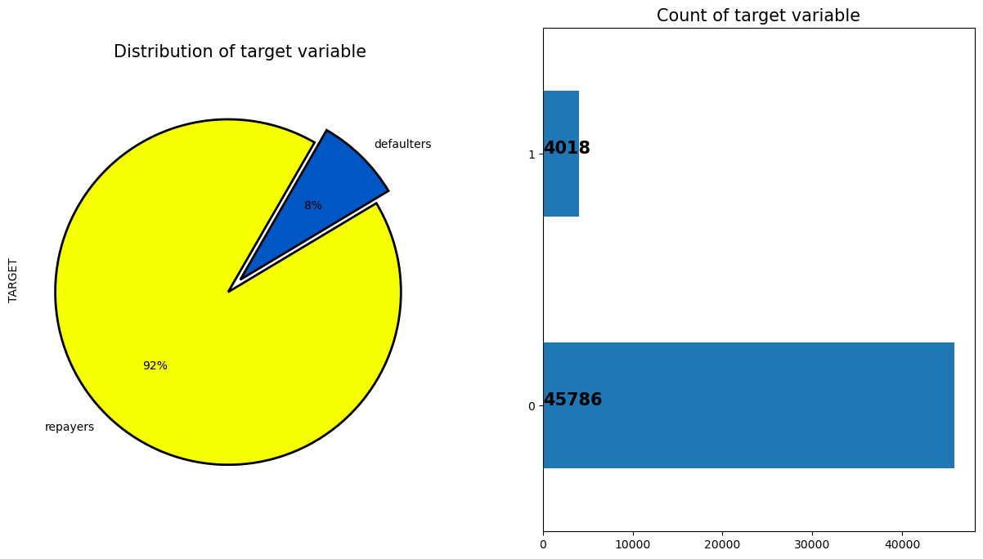
Data Imbalance
C. Data Imbalance analysis
Dafault rate is 0.08 in the application_data
application_data is highly imbalanced with only 8% data belongs to dafault(1) category and 92% data are in repayers(0) category.

Slide 8
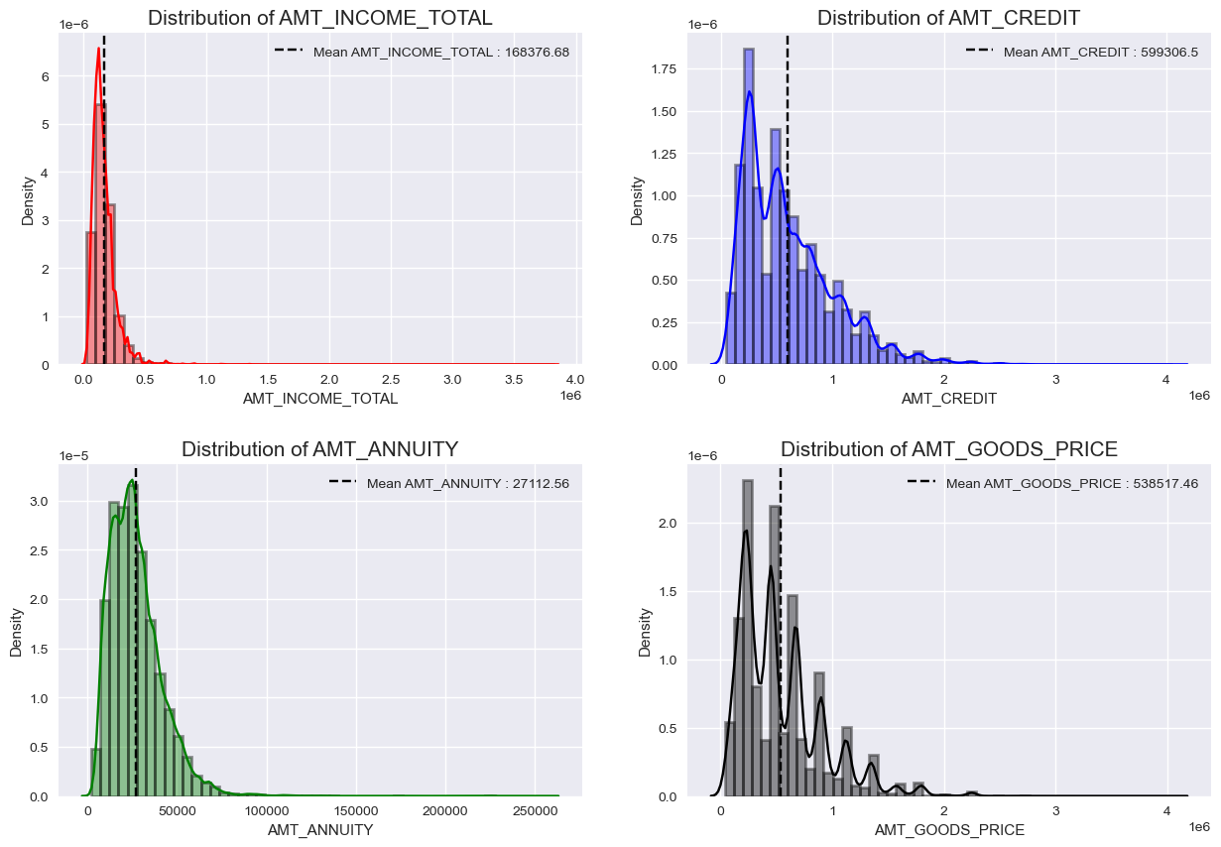
Insights
D. Univariate Analysis of numerical variables
income of the client's are highly skewed, about 99% of the borrowers have income less than 5lakhs.
Credit amount of the loan is mostly less then 10 lakhs
Most people have annuity below 50,000 for the loan
Most no. of loans are given for goods price below 10 lakhs

Slide 9
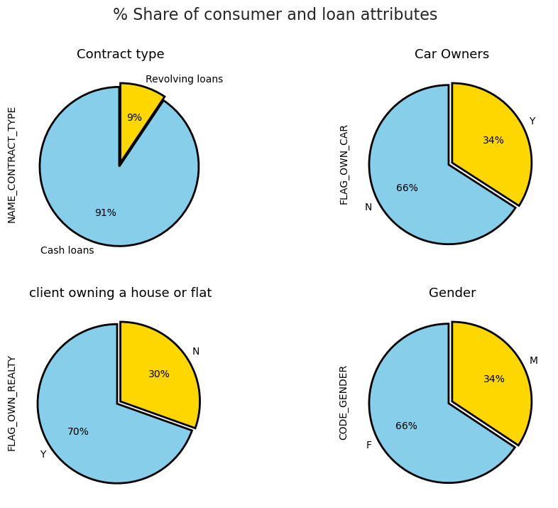
66% Clients of the bank are Females, 70% have house or flat
D. Univariate Analysis of categorical variables
most of the contract type is cash loans(91%)
only 34% clients are car owners
majority clients(70%) have house or flat.
and majority clients(66%) are females

Slide 10
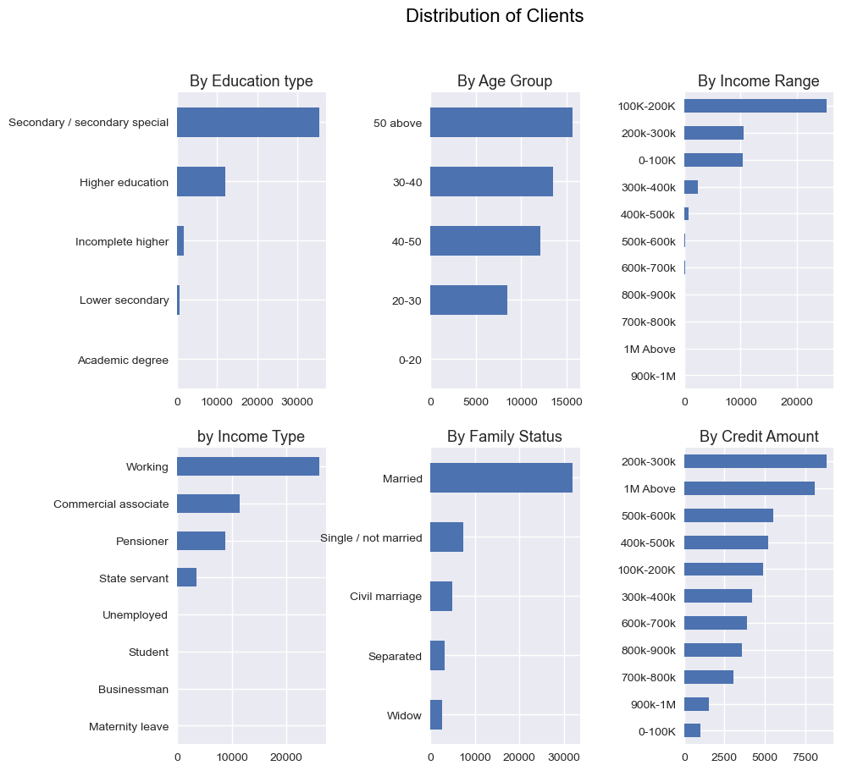
Maximum clients of the bank are above 40 yrs. old, working type and married
D. Univariate Analysis of categorical variables
secondary & Higher education are top education type of clients
most clients are in the age group of 30-40 and 50 above
most clients are in the range of 100-200k income
most clients are credited amount in the range of 200k-300k
working type and married type are top clients

Slide 11
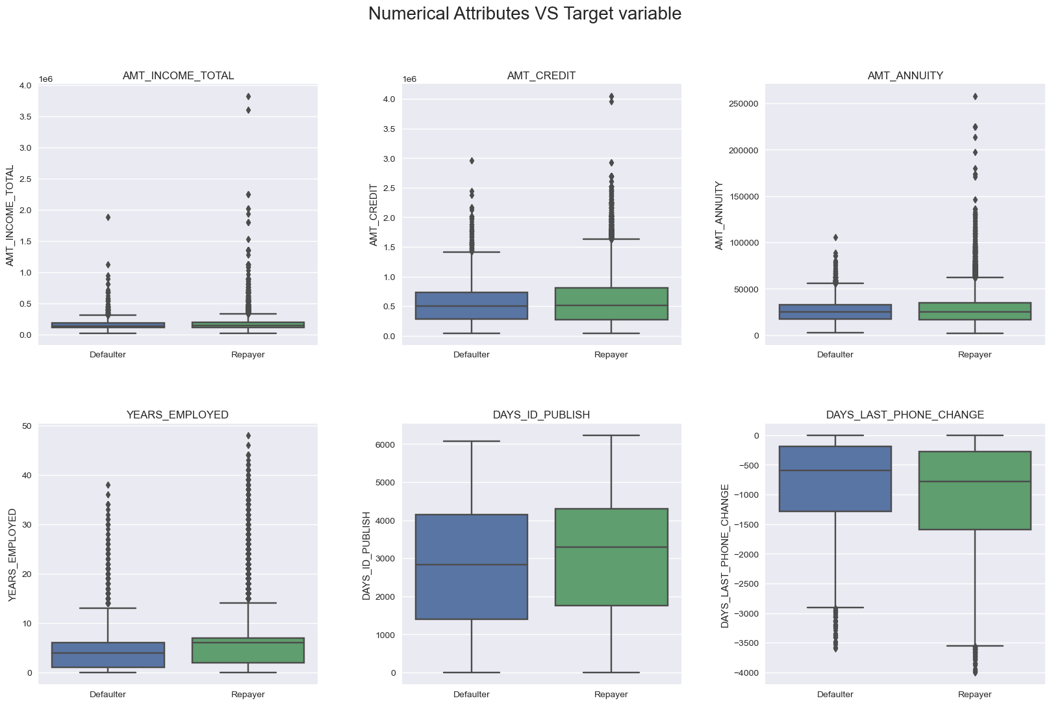
Median income of defaulters are same as repayors, but annuity, years of employment has lower values
D. Bivariate analysis to explore relationships between variables and the target variable
median income of defaulters are same as repayors, very high income clients are not defaulters.
median credit amount of defaulters are same as repayors, very high credit amount clients are not defaulters.
defaulters have median annuity amount, employment yrs, days last id updated values are slightly lower than repayors
defaulters have median days last phone change value is higher than repayors

Slide 12
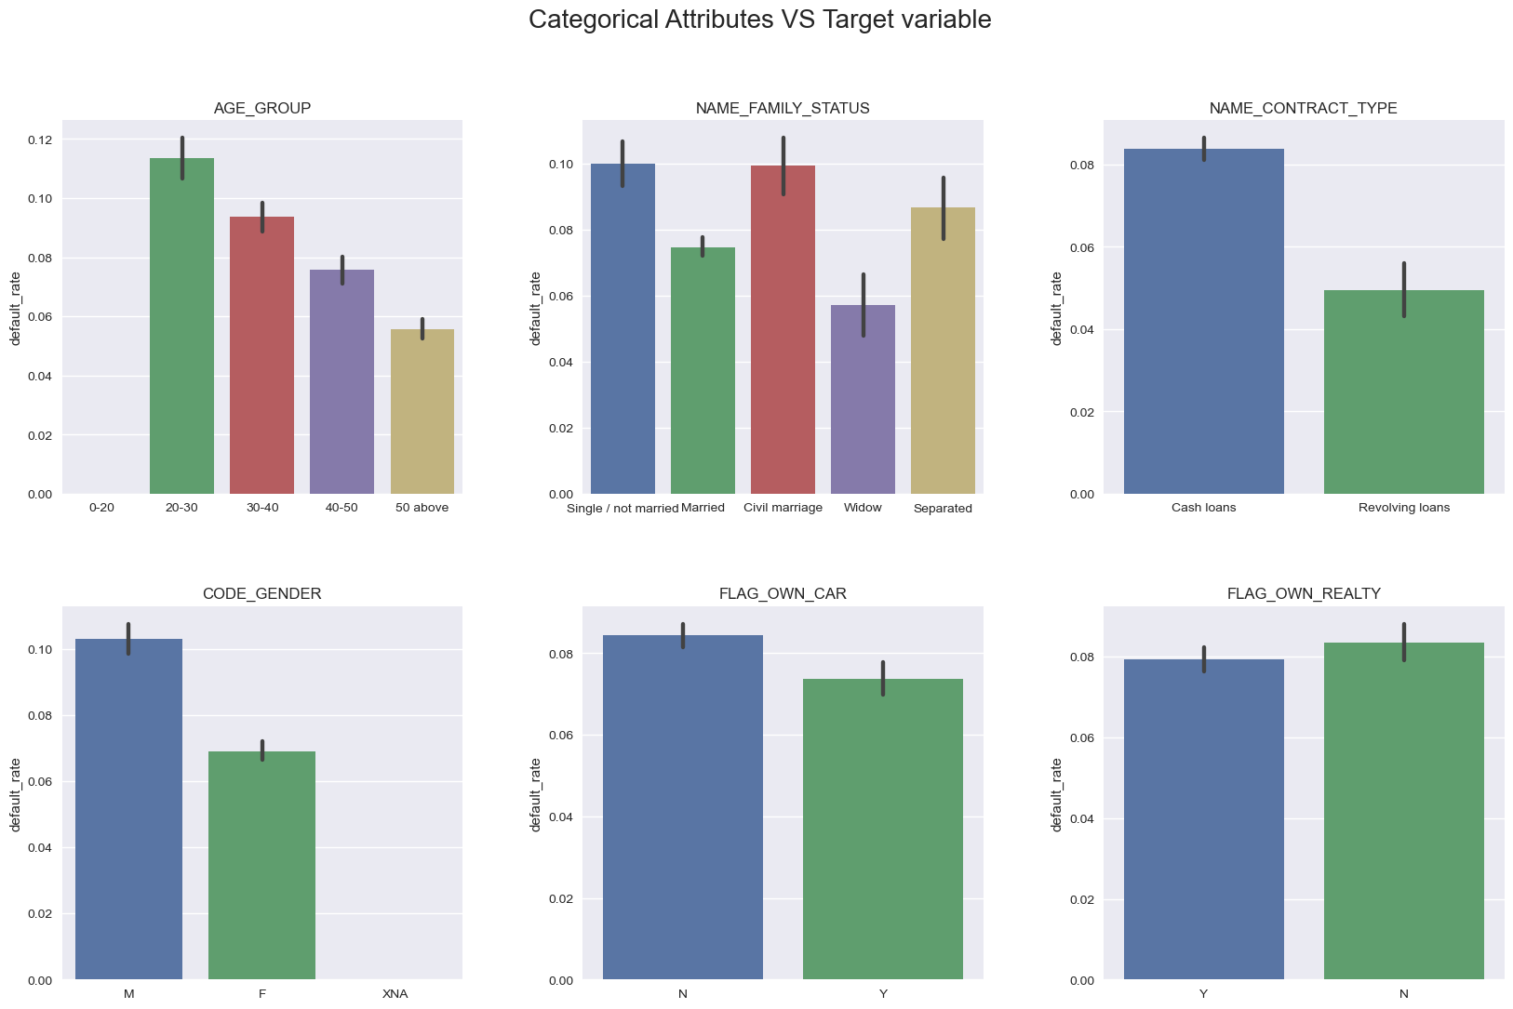
20-30 age group, civil married, singles have high default rate
D. Bivariate analysis to explore relationships between variables and the target variable
clients in 20-30 age group have highest default rate
civil married and single/not married clients have high default rate
cash loans contract type, people not owning car and house have higher default rate
males have higher default rate than females.

Slide 13
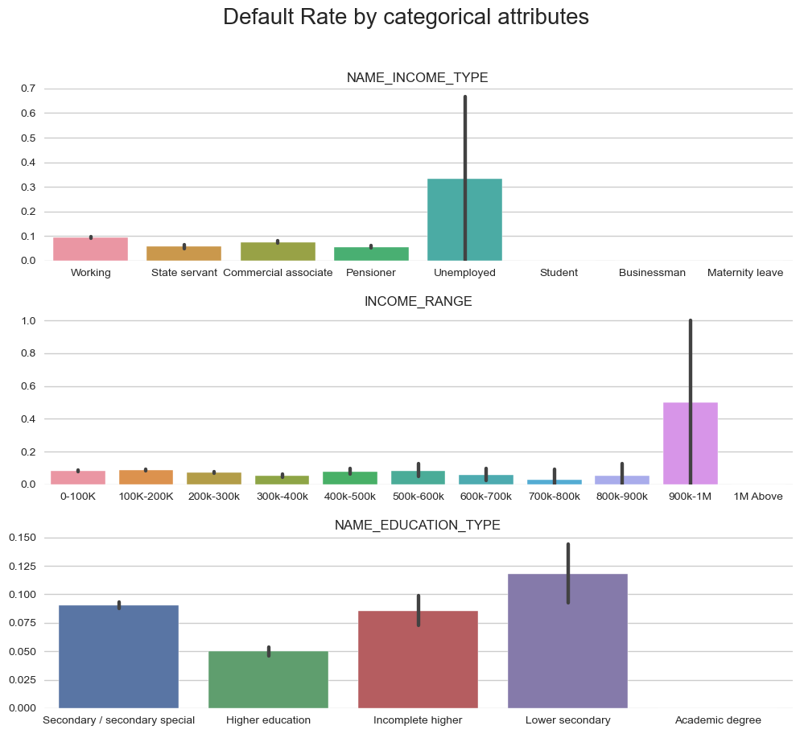
Unemployed, lower secondary and incomplete higher education type clients have high default rate
D. Bivariate analysis to explore relationships between variables and the target variable
unemployed clients have the highest default rate
people having income in the category 900k-1m have the highest default rate which is unexpected.
lower secondary and incomplete higher education type clients have higher default rate.

Slide 14
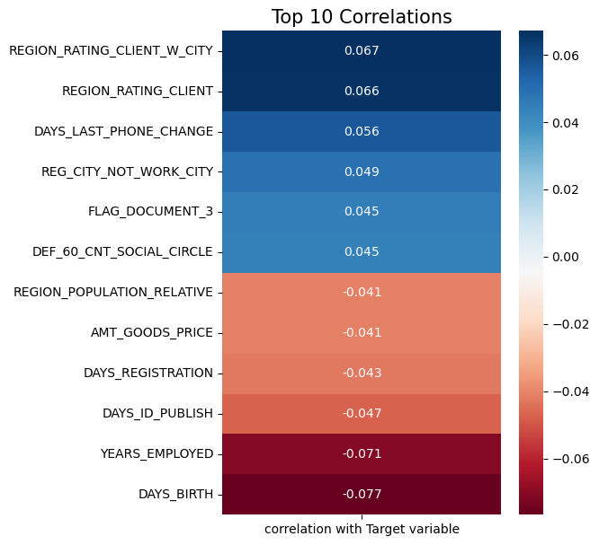
Client’s age, years of employment, Region rating, days last phone change are highly correlated with target variable
E. correlation between variables and the target variable
target variable is positively correlated with REGION_RATING_CLIENT, DAYS_LAST_PHONE_CHANGE, REG_CITY_NOT_WORK_CITY, FLAG_DOCUMENT_3 etc.
target variable is negatively correlated with DAYS_BIRTH, YEARS_EMPLOYED, DAYS_ID_PUBLISH, DAYS_REGISTRATION etc.

Slide 15
Results
Conclusions and recommendations :
Clients with High Region rating, not provided document 3, low days employment, days ID published, days registration should be denied loans as they are at high risk of default.
Clients with low annuity amount, unemployed, lower secondary or incomplete education type, single or civil married, belongs to age group 20-30 should be lend at high interest rate or lower amount as they are also at moderate risk of default.
Clients with very high income, annuity, credit amount, having higher education, owns car, house or flat are good customers for the bank. The bank should make strategies to attract them and make loan process easier for them.

Slide 16
Thank you

